Slide 1
Alchemy

Slide 2

By the end of this lesson, you should be able to:
Describe alchemy and some of its history.
Explain why some ideas of alchemy, such as transmutation, do not work.

Slide 3

Alchemy was a search for perfect, pure and magical materials that could prolong life or create great profit.
A practitioner of alchemy is called an alchemist. Their studies created many of the basic laboratory techniques, equipment and terminology that are still used today.
But alchemists heavily related their studies to magic and religion, leading to many conclusions we would find odd or unscientific today.

Slide 4

You may have heard of some alchemical concepts before.
Alchemists searched for materials such as the Philosopher's Stone, and the Elixir of Life.
They worked with mercury and tried to convert metals such as lead into gold. This process was called transmutation.
Most alchemists were secretive and paranoid, and wrote their work using codes and symbols unknown to others. It is often difficult to translate their notes because of this.

Slide 5
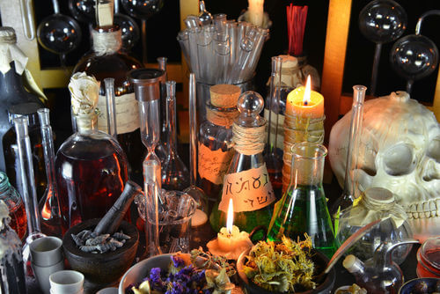
Alchemy was a way of understanding the physical and chemical world before modern chemistry was developed.
It was developed separately in three areas: India, China and the "West" (The Middle East and Europe).
These three branches of alchemy all shared common ideas, such as the conversion of metals to gold.

Slide 6
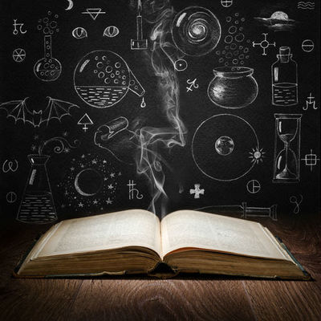
Indian alchemy is still poorly understood.
The name given to Indian alchemy, Rasaśāstra, means "The Science of Mercury."
Like much alchemy, it seems to have focused on the poisonous liquid metal mercury as a material used to transform materials.

Slide 7
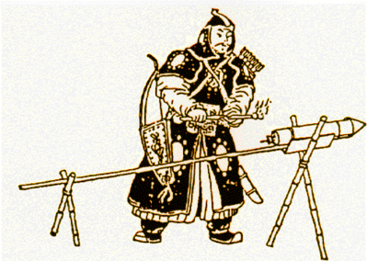
Chinese alchemy was more linked to medicine and the search for immortality.
It is thought that gunpowder was ironically created by an alchemist trying to create an elixir of life.
Mercury use was also common in Chinese alchemy - the emperor Qin Shi Huang died from consuming mercury tablets. They were supposed to grant him immortality.

Slide 8

Western alchemy was heavily based on Aristotle's model of the elements.
Aristotle believed that the universe is made up of four elements. These were air, water, fire and earth.
Every object was said to be created from a mixture of these four materials, called the classical elements.

Slide 9
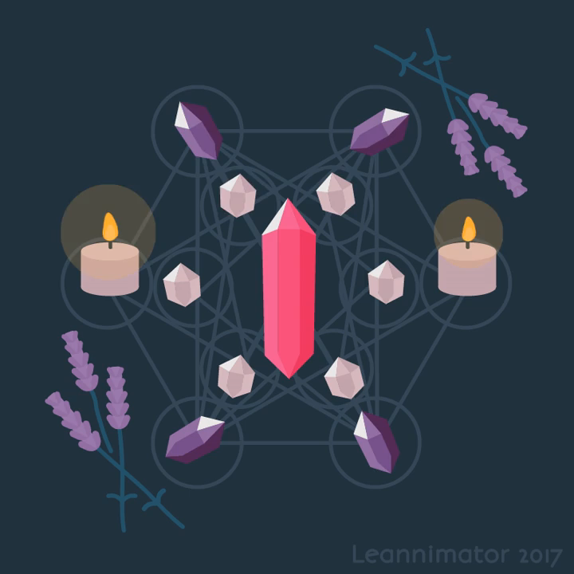
One aim of alchemy was the creation of the philosopher's stone.
You might recognize the philosopher's stone from the Harry Potter book series.
The stone was supposed to be able to convert metals into gold - but modern chemists now know this to be impossible. It also supposedly granted eternal life and great power.
The search for the stone was central to all alchemy across the world, as it symbolized perfection and enlightenment.

Slide 10

Time and chemistry have proven many of the alchemists' odd beliefs false.
But it is important to consider the achievements of the alchemists. All of chemistry relies upon techniques developed by the alchemists, along with materials that they discovered.
Removing the magical components from alchemy helped to develop it into chemistry, but it was these strange beliefs that made such advances possible.

Slide 11
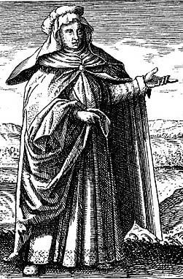
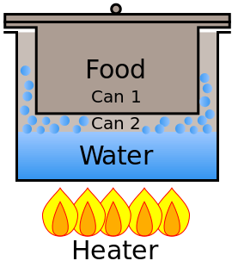
he first real Western alchemist was known simply as Mary, or Maria Prophetissima.
Mary was a Hebrew alchemist who lived in Egypt.
She is credited with the invention of several items of chemistry equipment, such as the bain-marie. This is a water bath used to heat materials gently and slowly - both for chemistry and cooking.

Slide 12
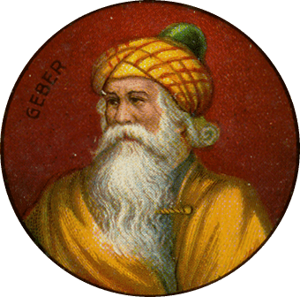
Jābir ibn Hayyān: The Father of Chemistry.
From the 7th century, alchemy was centred in Persia and Arabia.
The most famous alchemist of this time is Jābir ibn Hayyān. He introduced scientific methodology and controlled experimentation to alchemy.
Among other things, Jābir contributed to the discovery of the three core acids: hydrochloric, nitric and sulfuric.

Slide 13
Jābir's focus was Takwin, the artifical creation of life.
He developed aqua regia, a mixture of nitric and hydrochloric acids, which was able to dissolve gold. This was, of course, seen as important.
He also tried to develop the philosopher's stone, to transmute metals into different metals. Other Muslim scientists disputed that such a material could exist.
These people were practical chemists - they disagreed on the existence of metal transmutation, and approached science in a more scientific way.

Slide 14
Today, chemists use the scientific method.
The scientific method in a nutshell: a hypothesis is made, then an experiment is done, then a conclusion can be made about how valid the hypothesis was.
But in the past, a scientist would make a theory and then do experiments to confirm it, or even not bother to confirm it at all.
Alchemists helped to introduce the idea of experimentation to Europe, but it would take many years to turn this into the scientific method.

Slide 15
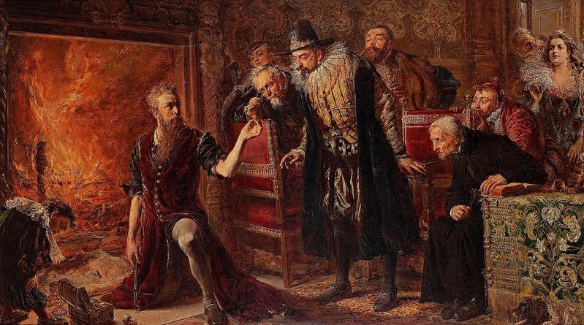
Many alchemists also worked on other sciences at the same time.
The great astronomer Tycho Brahe, for instance, was also an alchemist who produced effective herbal remedies.
A Polish alchemist, Sendivogius, performed experiments on purfiying many metals and acids. He is the one who discovered that air is not a pure substance and contains what he called a "food of life" - oxygen.

Slide 16
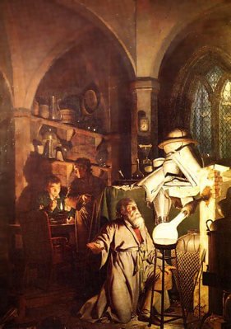
The element phosphorus was discovered by an alchemist, Hennig Brand, in 1669 - entirely by accident.
Brand was trying to create the Philosopher's stone from urine, since both urine and gold are golden in colour. Instead he made a white powder that glowed. Phosphorus was the first element to be isolated that does not already occur naturally in the Earth.

Slide 17
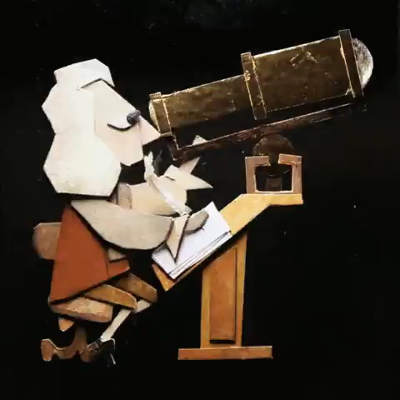
Sir Isaac Newton is regarded as one of the greatest scientists of all time.
He theorised the law of gravitation and also developed the mathematical study of calculus. But his true life's work was alchemy and the occult.
Newton spent much time working on the Philosopher's Stone and studying the end of the world, Atlantis and the Temple of Solomon.

Slide 18
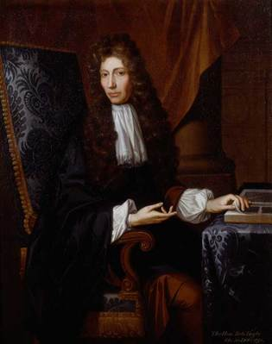
Working slightly before Newton was the Irish alchemist Robert Boyle.
Boyle acted more like a modern chemist than an alchemist. He made no assumptions in his experiments, and noted every possible variable in case it was relevant. Boyle was pioneering the scientific method. Boyle's work lead to the founding of modern chemistry as a respectable science. By the 17th century, alchemy had fallen from style and alchemists were regarded as little more than frauds.

